Slide 1
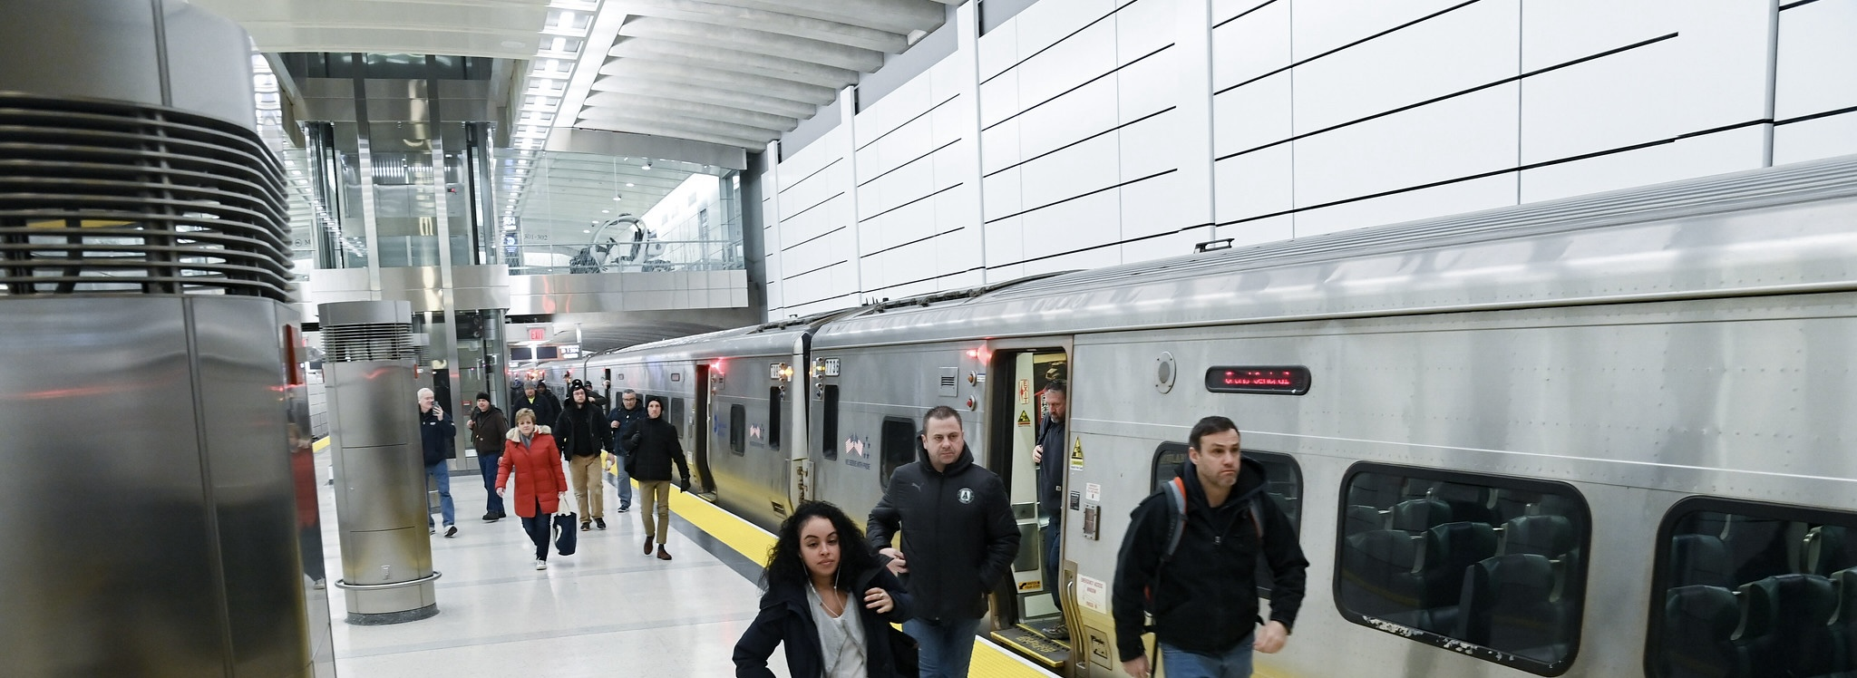



MTA
“The Metropolitan Transportation Authority”

Slide 2

Content :
Team
Introduction
Dataset Overview
Project Building
Insights

Slide 3
Team
1- Mohamed Fathy.
2- Mostafa Gamal.
3- Zenib Ibrahim.
4- Hazem.
5- Esraa ElMalawy.
6- Abanob Samir.

Slide 4
Introduction

Slide 5
Dataset Overview

Slide 6
Project Building
1- Data Cleaning:
2- Visuals :

Slide 7
Project Building: 1- Data Cleaning
1- Data Cleaning
2- Table Cutting
3- Create Column
4- Create Measures

Slide 8
Project Building: 1- Data Cleaning
1- Data Cleaning
2- Table Cutting
3- Create Column
4- Create Measures

Slide 9
Project Building: 1- Data Cleaning
1- Data Cleaning
2- Table Cutting
3- Create Column
4- Create Measures

Slide 10
Project Building: 1- Data Cleaning
1- Data Cleaning
2- Table Cutting
3- Create Column
4- Create Measures

Slide 11


Project Building: 2- Visuals (main+7 Visuals)
B&T
NYCT
LIRR
ARR
MTABC
SIR
MNR

Slide 12
B&T
NYCT
LIRR
B&T
ARR
MTABC
SIR
MNR

Slide 13
B&T
NYCT
LIRR
B&T
ARR
MTABC
SIR
MNR

Slide 14
B&T
NYCT
LIRR
B&T
ARR
MTABC
SIR
MNR

Slide 15
B&T
NYCT
LIRR
B&T
ARR
MTABC
SIR
MNR

Slide 16
B&T
NYCT
LIRR
B&T
ARR
MTABC
SIR
MNR

Slide 17
B&T
NYCT
LIRR
ARR
MTABC
SIR
MNR

Slide 18
services
history
teams
B&T
timeline
ARR
MTABC
NYCT
MNR
SIR
LIRR

Slide 19
services
history
teams
B&T
timeline
ARR
MTABC
NYCT
MNR
SIR
LIRR

Slide 20
services
history
teams
B&T
timeline
ARR
NYCT
MNR
MTABC
SIR
LIRR

Slide 21
services
history
teams
B&T
timeline
ARR
NYCT
MNR
MTABC
SIR
LIRR

Slide 22
services
history
teams
ARR
B&T
NYCT
timeline
MTABC
MNR
SIR
LIRR

Slide 23
services
history
teams
ARR
B&T
NYCT
timeline
MTABC
MNR
SIR
LIRR

Slide 24
services
history
teams
B&T
timeline
ARR
NYCT
MNR
MTABC
SIR
LIRR

Slide 26
Thank You

